Slide 1

Applied Data Science Capstone
Project: Tenedor Gaucho
By Florencia Paradeda

Slide 2
Background
Argentina is a large country in South America. Best know for it’s most famous soccer player: Lionel Messi, but also for it’s amazing cuisine.
The best steak in the world, empanadas and locro are only a few examples of a large variety of unique delicacies.
Argentinians are explores. Most Argentinians are descendants of immigrants who pursed a different, better life, so exploration is part of our lives. About 1 million Argentinians living abroad, usually in large cities, and often show the world the wonders of such unique cuisine.
Argentina’s capital city, Buenos Aires, is an electric, hectic location with a wonderful architecture, very active nightlife, and a wide offer of both local and international restaurants. It attracts 2 million of international tourists every year who spend 33% of their travel budget in restaurants.

Slide 3
Objective
The objective of this project is to demonstrate that New York City provides an attractive opportunity for an Argentinian Restaurant
This analysis will result of interest for Argentinians living in such cities, or for investors looking for business opportunities.

Slide 4
Analysis overview
Data and sources
Identify the large cities in the world with significant number of Argentinian residents.
This data will be sourced primarily from Wikipedia where latest city’s census can be found.
Identify the number of venues under the “Argentinian Restaurant” category, along with other categories that may be relevant for comparison purposes.
Information available in Foursquare will leverage this analysis
Review international tourism data visiting Buenos Aires on a yearly basis.
This information will be sourced by INDEC, the Argentina statistics office.
Data analysis and statistical applications
Perform a series of correlation analysis to identify any existing relationship between the number of Argentinian residents and the number of Argentinian restaurants.
Identify cities where a lower number of Argentinian restaurants results in a business opportunity.
Analyze the geospatial distribution of venues in the cities of interest

Slide 5
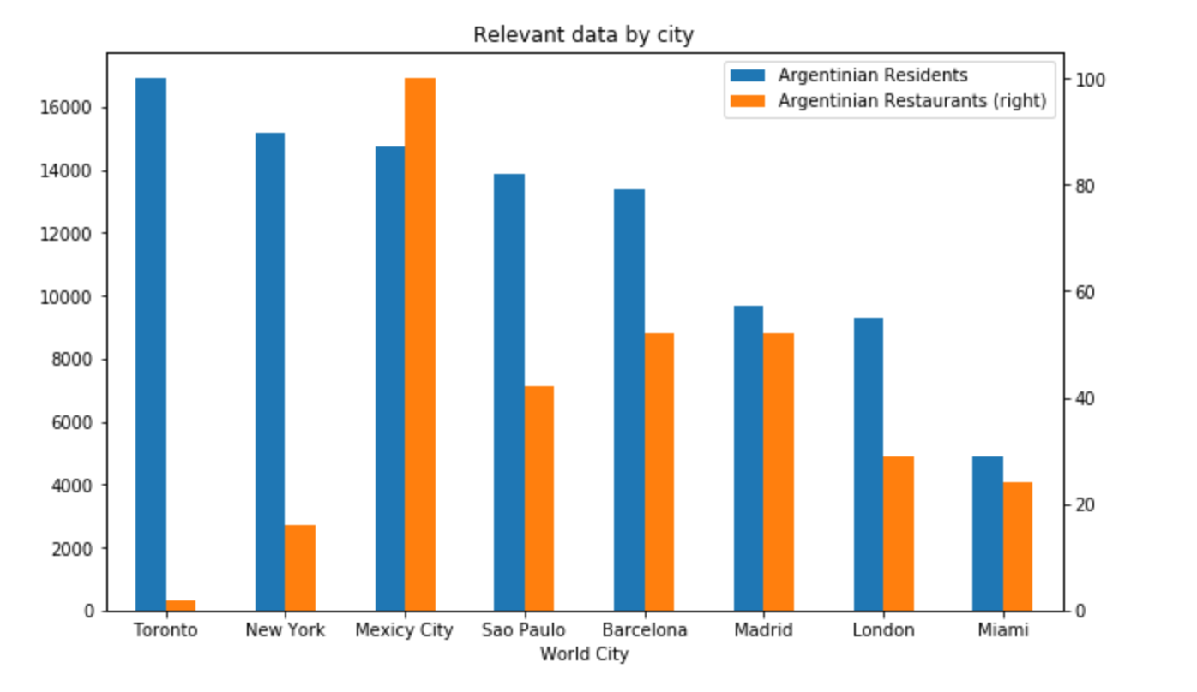
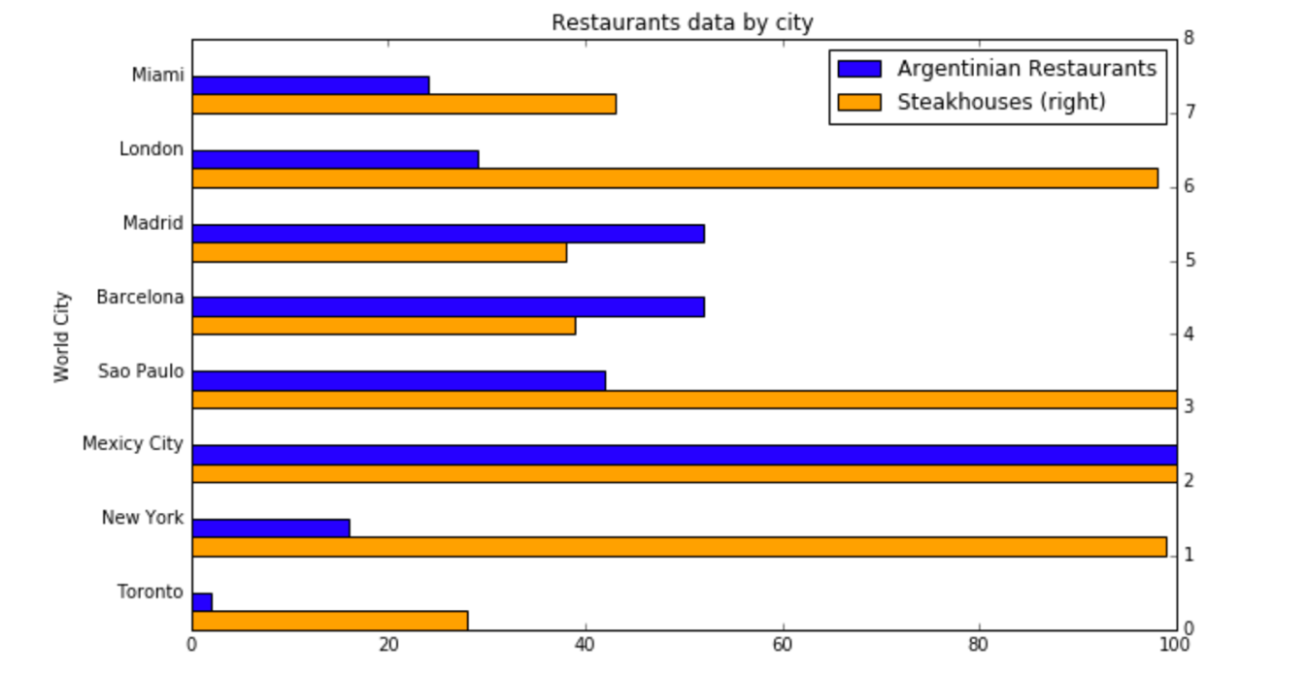
Preliminary Observations
Considering cities where there is a large number of Argentinian residents and steak houses, we can observe a low number of Argentinian restaurants in New York and Toronto.
This initial observation suggests a statistical comparative analysis to support the opportunity for opening an Argentinian restaurant.

Slide 6
Statistical analysis
This hypothesis will be proven by comparing the correlation results for the following two groups of cities:
For group number 2 both Toronto and New York data are removed. The rest of the data remains the same
Group 1: 8 cities | Group 2: 6 cities
Toronto
New York
Mexicy City | Mexicy City
Sao Paulo | Sao Paulo
Barcelona | Barcelona
Madrid | Madrid
London | London
Miami | Miami

Slide 7
Statistical summary
Considering 8 cities
The correlation between Argentinean residents and restaurants is about 0.05
Pearson Correlation Coefficient 0.04732899955472767
P-value of P = 0.9113905599999204.
Considering 6 cities
The correlation between Argentinean residents and restaurants is over 0.7
Pearson Correlation Coefficient is 0.7102554536600942
P-value of P = 0.11376555030152359,

Slide 8
Discussion
Supporting observations
Other large cities with a large number of Argentinian Residents offer a larger number of Argentinian restaurants.
Both Toronto and New York have a statistical potential for growth in the offer of Argentinian food
The number of Steakhouses in New York is considerably larger than other cities, which demonstrate the interest for this type of food.

Slide 9
Conclusion
The performed analysis supports the hypothesis described in the Objective:
New York is the best location for investing in an Argentinian Restaurant

Slide 10
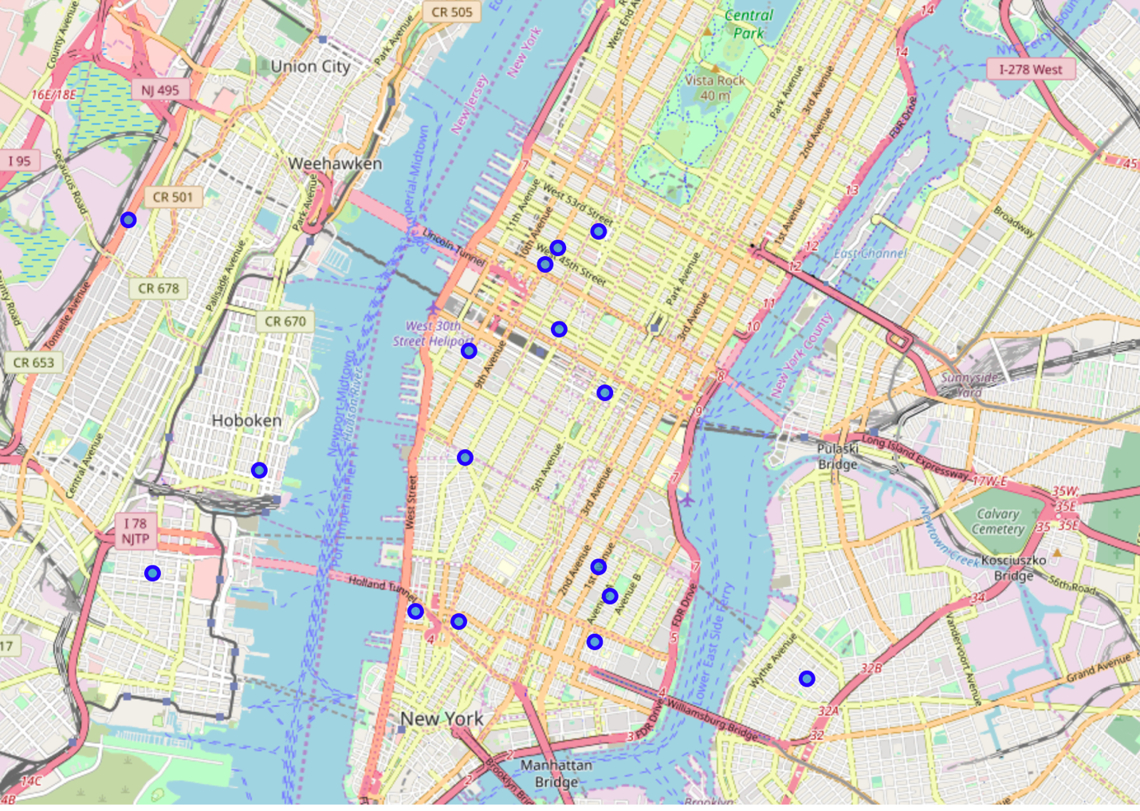
Distribution of Argentinean Restaurants in New York City.

Slide 11
Back Ups

Slide 12
Data Sources
Argentinian living abroad source data:
https://es.wikipedia.org/wiki/Emigraci%C3%B3n_argentina
Argentina international tourism statistics :
https://www.indec.gob.ar/uploads/informesdeprensa/eti_02_19.pdf
https://tradingeconomics.com/argentina/tourist-arrivals
Mexico international tourism statistics:
https://www.yvera.tur.ar/estadistica/documentos/descarga/5a0c8e8d4c5c0.pdf
Argentina and New York tourisim partnership
https://business.nycgo.com/press-and-media/press-releases/articles/post/new-york-city-and-buenos-aires-sign-first-ever-city-to-city-tourism-partnership/
Other relevant data
https://business.nycgo.com/press-and-media/press-releases/articles/post/new-york-city-and-buenos-aires-sign-first-ever-city-to-city-tourism-partnership/
https://www.cronista.com/clase/break/Cuanto-y-en-que-gastan-los-turistas-que-llegan-a-la-Ciudad-de-Buenos-Aires--20190905-0004.html
https://newsroom.mastercard.com/wp-content/uploads/2019/09/GDCI-Global-Report-FINAL-1.pdf
https://tradingeconomics.com/argentina/tourist-arrivals

